Slide 1
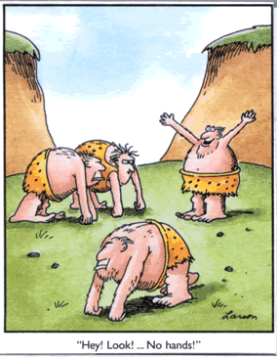
Hominins
Living and fossil species belonging to the human lineage
Links
Fossils
Waikato Uni
Hunterian

Slide 2
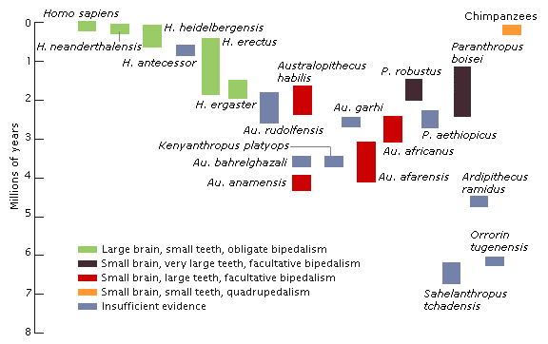

Slide 3
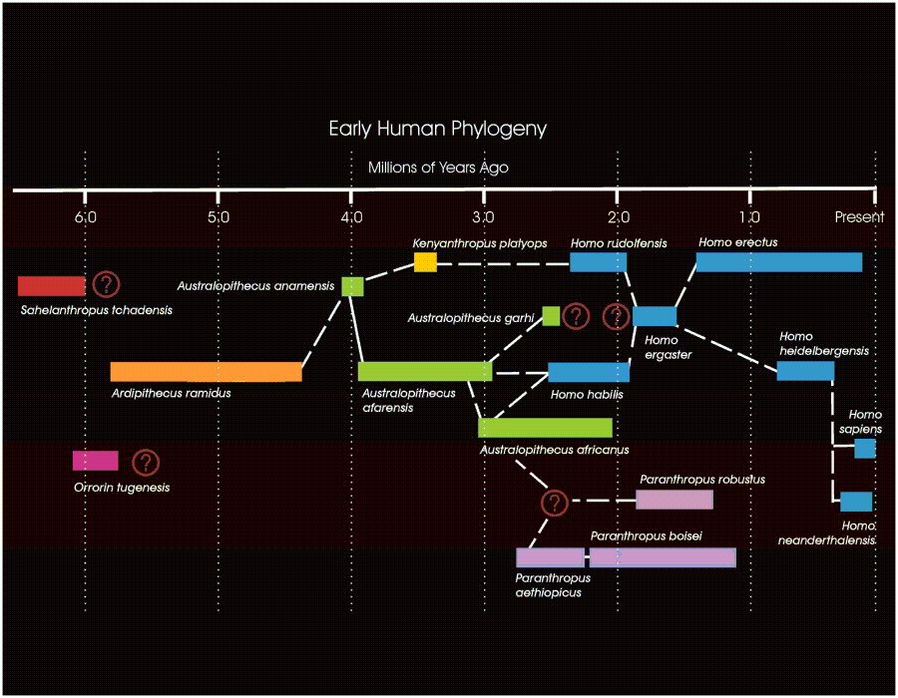

Slide 4
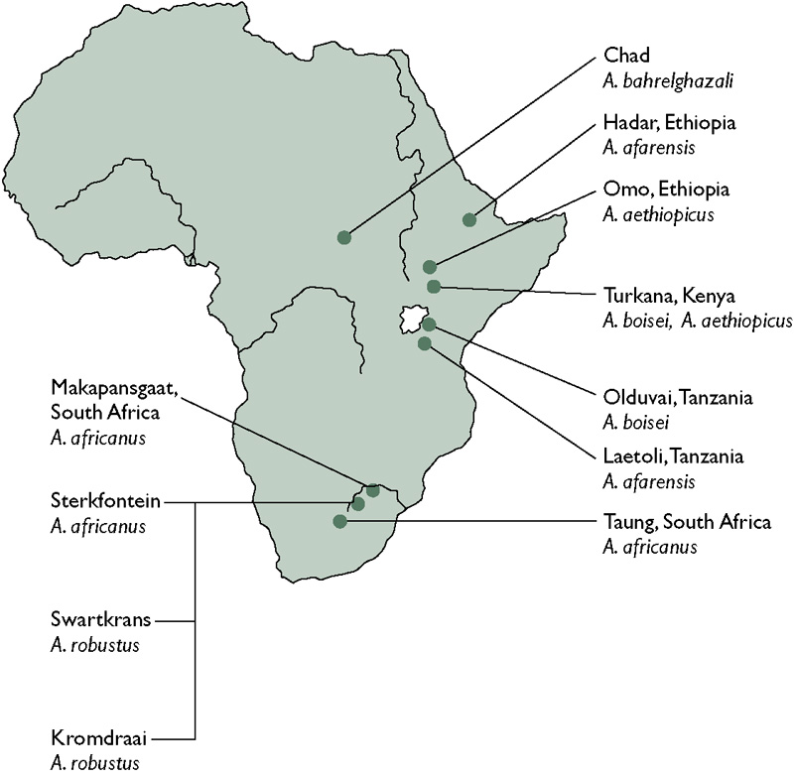

Slide 5
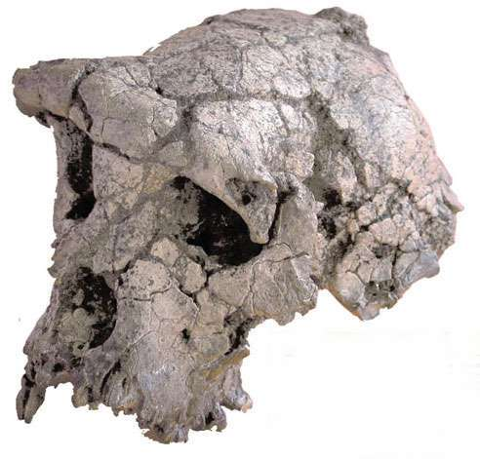
Sahelanthropus tchadensis
“Sahel hominid from chad”.
6 – 7 m.y.a. (about the time our line split off)
  brain (350cc) & skull chimp-like but thicker brow ridges and face flatter
  Smaller canine teeth than chimp

Slide 6
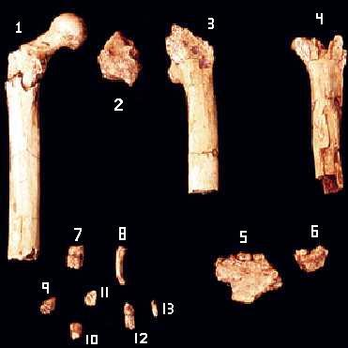
Orrorin tugenensis
“Original Man” (page 217)
6 m.y.a.
Arm and thigh bones, lower jaws, and teeth.
Chimp size.
Upright walking?
Smaller canines, thick enamel
Lived in dry forest?

Slide 7
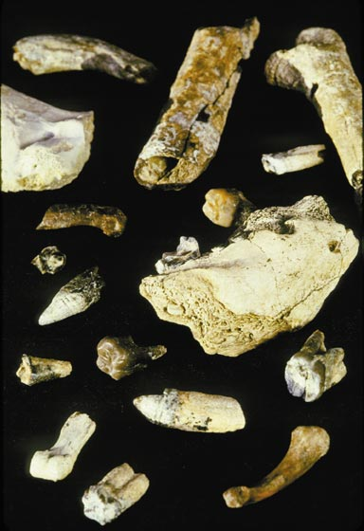
Ardipithecus kadabba
Kadabba = “basal family ancestor".
5.54 – 5.77 m.y.a

Slide 8
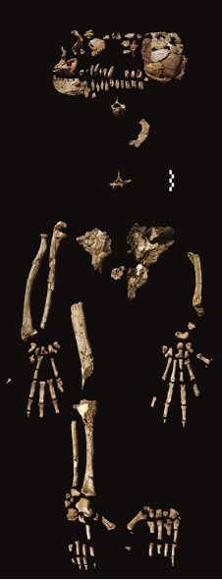
Ardipithecus ramidus
In the Afar language Ardi means "ground". 'Ramid' means 'root‘. Pithecus = ape
4 – 6 m.y.a. (“Ardi” 4.4 m.y.a.)
About 120 cm tall and 50 kg.
Ape-like upright walker – suggested by toe structure.
Feet well adapted to grasping, (big toe not in line with others) and able to climb trees. The structure of Ardi's feet, pelvis, legs and hands suggest that she was a biped on the ground, but a quadruped in the trees. Did NOT knuckle walk.
Chimp sized brain.
Teeth resemble modern human teeth more closely than they do those of a chimpanzee.
Lived in woodland conditions.

Slide 9
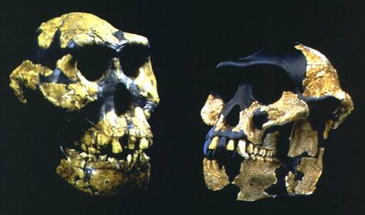
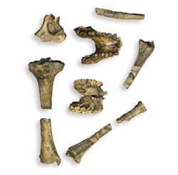
Australopithecus anamensis
Austral = southern
Turkana word anam, meaning "lake".
3.9 – 4.1 m.y.a.
Upright walking

Slide 10
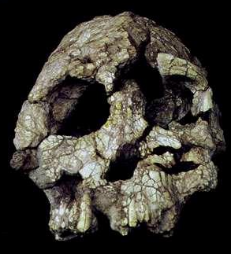
Kenyanthropus platyops
Flat faced man of Kenya
3.2 – 3.5 mya
Brain 350cc
Toe bone suggests upright.
Around same time as A. afarensis.
Controversial - may be A. afarensis or other hominin.

Slide 11
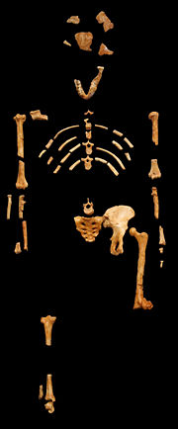
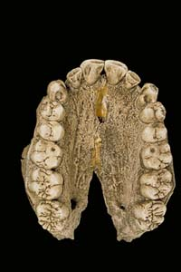
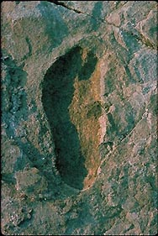
Australopithecus afarensis “Lucy”
Afar is an area in N.E. Africa
2.9 – 3.9 m.y.a.
Upright walking
Small brain (430 cc average)
Sexual dimorphism

Slide 12
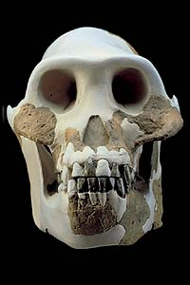
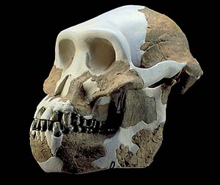
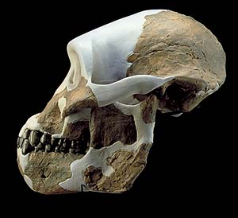
A. afarensis skull
Ape-like
Large canines and diastema

Slide 13
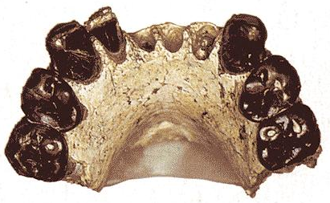
Australopithecus bahrelghazali
Bahr el ghazali = a valley in Chad
3 – 3.5 mya
Appears similar to A. afarensis, but from central Africa.
This is all there is of it!!!

Slide 14
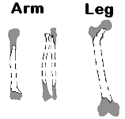
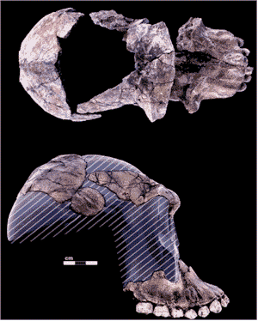
Australopithecus garhi
Garhi = surprise in Afar language
2.5 m.y.a
Cranial capacity 450cc
Big canine teeth like A. afarensis,
  but bigger molars
Tool user?

Slide 15
Australopithecus africanus
(“Southern ape of Africa")
First Australopithecine found
2 – 3 m.y.a.
Slightly more human-like than A. afarensis
Brain 430 – 520 cc
Less sexual dimorphism

Slide 16
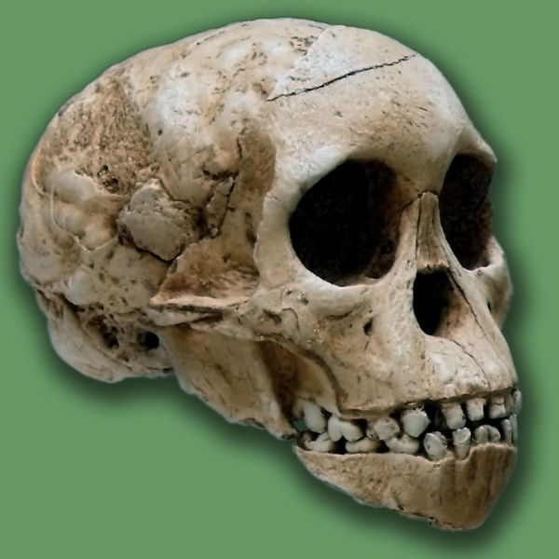
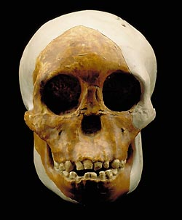
Taung Child
Australopithecus africanus

Slide 17
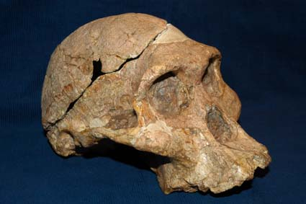
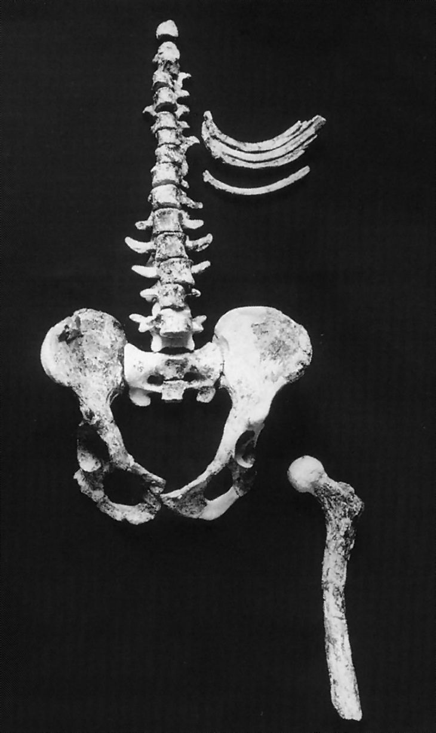
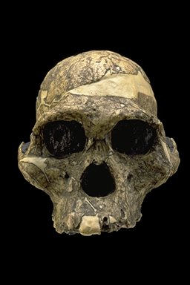
“Mrs. Ples”
A. africanus

Slide 18
Gracile or Robust
Australopithecus afarensis and africanus, and the other species above, are known as gracile australopithecines, because of their relatively lighter build, especially in the skull and teeth.
The following Paranthropus species (formerly also called Australopithecus) are called robust australopithecines because of their heavier build. This is probably related to a diet of coarse plant foods.

Slide 19
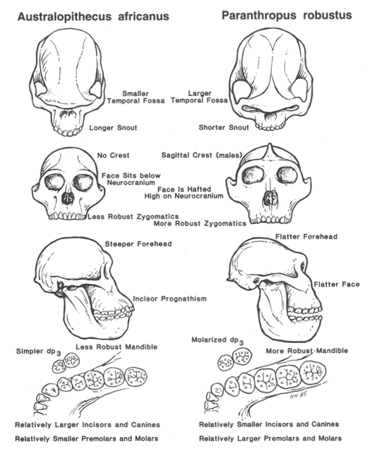

Slide 20
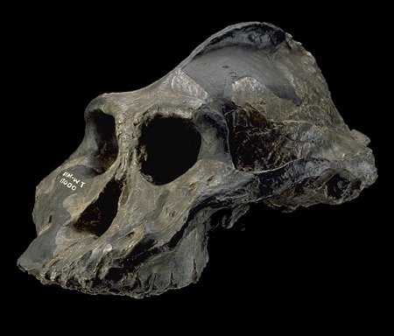
Paranthropus aethiopicus
Greek para "beside", Greek anthropos "human"
Aethiopicus - Ethiopia
Primitive features (e.g. prognathic face) shared with A. afarensis, but more robust.
2.5 – 2.7 m.y.a.
Brain size 410 cc.
The Black skull

Slide 21
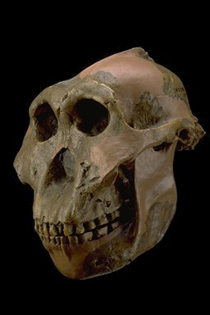
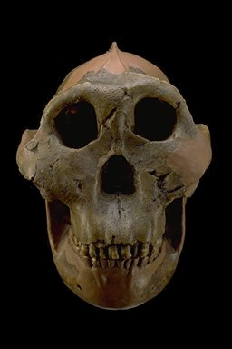
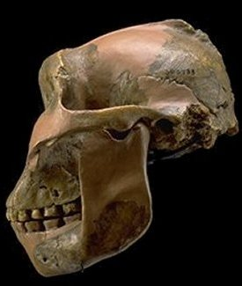
Paranthropus boisei
Charles Boise funded Leaky’s expedition.
1.2 – 2.5 m.y.a.
Brain 500 – 530 cc
Marked Sexual dimorphism
East Africa
Zinj

Slide 22
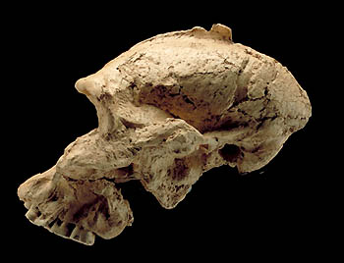
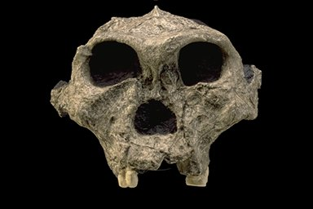
Paranthropus robustus
Robust = heavy build
1 – 2.5 m.y.a
Brain 450 – 550 cc
Moderate Sexual dimorphism
South Africa

Slide 23
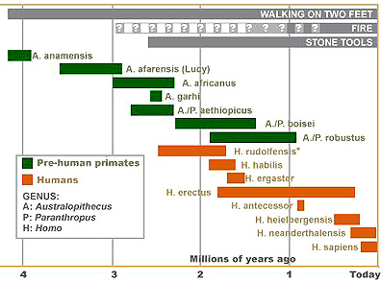

Slide 24
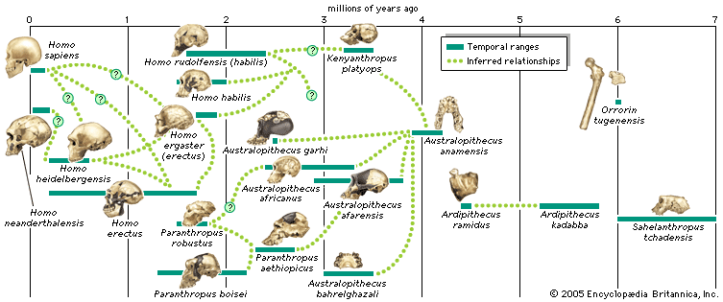

Slide 25
Australopithecus sebida
About 2 million years ago Approximately 1.3 meters tall. May be transitional between A. africanus and Homo Its cranial capacity is estimated at around 420-450 cm³, Modern hand, whose precision grip suggests it might have been tool-making If not a transitional species, it may have been a late southern African branch of Australopithecus coexisting with already existing members of the Homo genus.

Slide 26
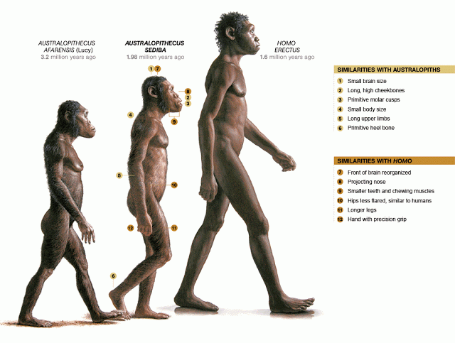
Australopithecus sebida

Slide 27
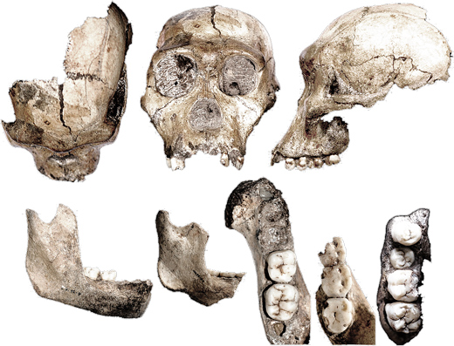

Slide 28
Walking
The combination of traits in Australopithecus sediba shows transition from a form adapted to partial arboreality to one adapted to bipedal walking.
The legs and feet point to a previously unknown way of walking upright. With each step, Australopithecus sediba turned its foot inward with its weight focused on the outer edge of the foot. This odd way of striding may mean that upright walking evolved on more than one path during human evolution.

